Slide 1
Report for [SWAN] 2021.11 mass production inspection_rev01 BFX – UA300
Date : 25-Nov-2021
Prepared by: Robert
Reviewed by: Toney Tu

Slide 2
Issue Description
ALT customer complain [BFX-UA300] issue [SWAN] 2021.11 mass production inspection_rev01
Overall inspection result => Fail (Waived, due to product launch schedule)
Defect Total:
Critical
Side LED not working * 1pcs
Major
BTV deco plate broken * 1pcs
BTV deco plate cosmetic NG * 3pcs
Missing accessory * 4pcs
Grill attachment NG * 1pcs
Minor
Side deco plate poor attachment * 10%

Slide 3

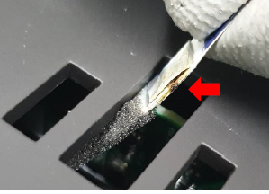
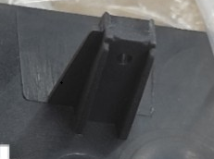
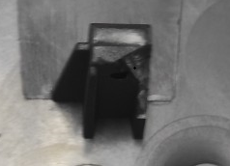
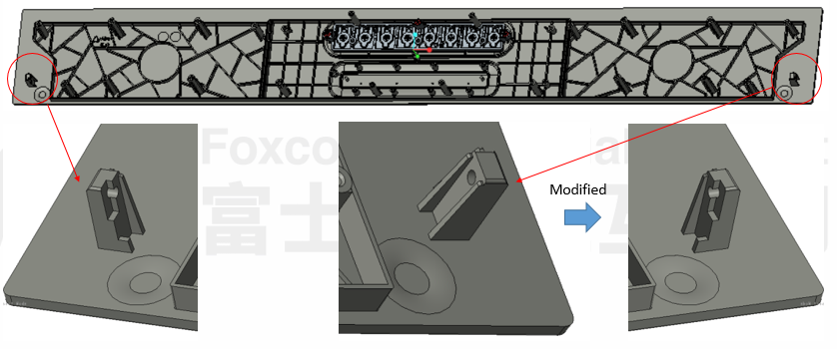
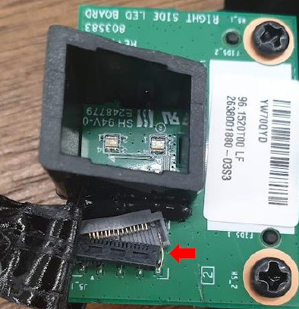
1. Side LED not working
Issue Description | Root Cause | Actions | Owner | Due Date | Status
Symptom: Side LED not working Type: Critical Defect Q’ty: 1/244pcs Defect rate : 0.4% SKB SN: 214965001202109002439 | 1. Design issue: Space between the screw boss of top cover and FFC connector is too tight, and stick 3M tape on FFC connector, the screw boss was interfered with 3M tape and FFC connector → It’s easy to cause the FFC connector damage. 2. Workmanship issue. Short term solution is FXN cut a Part (Rib) of the Hook. But it’s difficult to control the cutting quality. OP sometimes can’t cut well. | Short term action: Training OP to follow SOP to cut a part (Rib) of the Hook. Housing incoming issue still 13K. Long term action: 1. Setting up new auto test the side LED in test station. 2. ALT push vendor to improve the housing structure as below after the 13K. | ME: Manh TE: Mark RD: Jim | Done 2022- Jan-15
Before cut
After cut: Cut standard

Slide 4
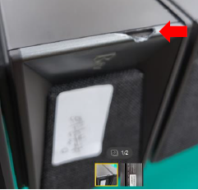

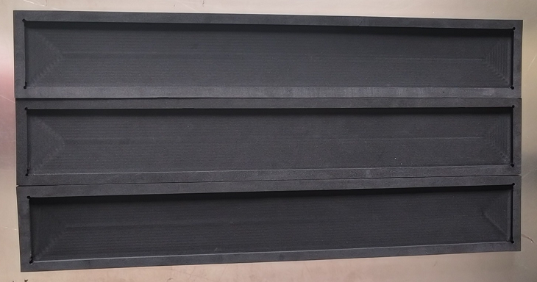

2. BTV deco plate broken
Issue Description | Root Cause | Actions | Owner | Due Date | Status
Symptom: BTV deco plate broken Type: Major Defect Q’ty : 1/244pcs Defect rate : 0.4% SKB SN: 214965001202109001832 | 1. VI OP did not detect any BTV deco plate broken issue before. 2. Checked 12 remaining units in warehouse, and did not find any units have BTV deco plate broken. ➔FXN don’t find out the root cause and keep monitor it. | 1. Update NG picture to SOP for reminded OP at VI station to inspect the BTV deco plate before put product into box. 2. Buy special tray to put product in to avoid housing is broken in production process. 3. Update OBA SIP to inspect the BTV deco plate. | IE: Linh ME: Manh PQE: Robert | Done 2022- Jan-15 Done
NG

Slide 5
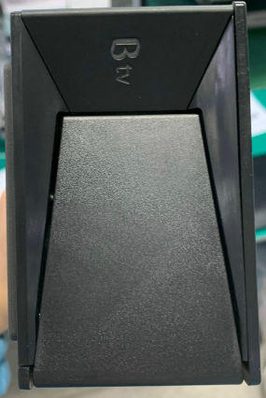
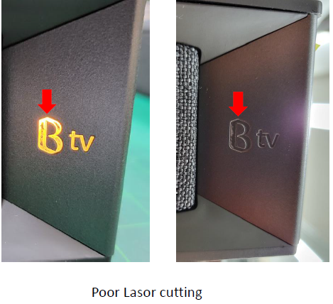
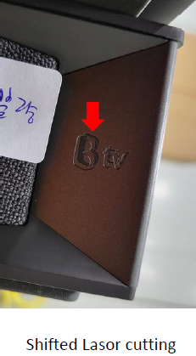


3. BTV deco plate cosmetic NG
Issue Description | Root Cause | Actions | Owner | Due Date | Status
Symptom : BTV deco plate cosmetic NG Type: Major Defect Q’ty : 3/244pcs Defect rate : 1.33% SKB SN: 214965001202109002410 214965001202109002400 214965001202109001832 | Incoming material issue. Vendor: INKEL Visual inspection criteria did not define the laser cutting standard. 1. At VI station, Op did not detect the BTV deco plate cosmetic NG issue before put product into box. 2. IQC didn’t find the BTV deco plate cosmetic NG issue based on the sampling plan C=0, AQL=0.4. 3. OBA didn’t find the BTV deco plate cosmetic NG issue. | 1. Request RD provide inspection criteria for deco item. 2. Update NG picture to SOP for reminded OP at VI station inspect BTV logo before put product into box. 3. Update the BTV deco plate OK and NG picture to IQC SIP. 4. Update the BTV deco plate OK and NG picture to OBA SIP. 5. FXN SQE informs with vendor to improve this issue and give 8D report. | RD: Jim IE: Linh SQE: Tuan PQE: Robert SQE: Tuan | 11/30 Done Done Done 11/30
NG
0k

Slide 6
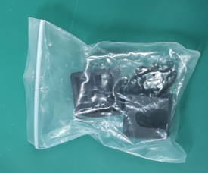
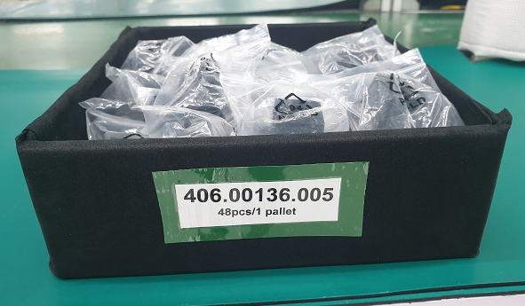
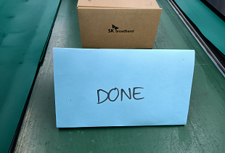
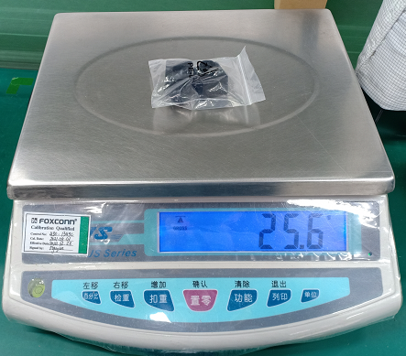
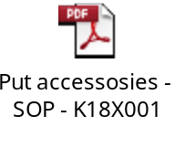
4. Missing accessory
Issue Description | Root Cause | Actions | Owner | Due Date | Status
Symptom: Missing wall mount bracket inside the adaptor box Type: Major Defect Q’ty : 4/244pcs Defect rate : 1.78% | Workmanship issue. 1. Wall mount without barcode for key parts control by scanning during packing. 2. At packing station, Op forgot to put in wall mount into Adapter box. 3. The weight of wall mount is 25g . It has risk to escape from check weight station. (weight tolerance: +/- 15g) | 1. Follow DFM item, request RD push vendor to add barcode for key parts control. 2. Quantitative control: 48 units per pallet At pack box station, put 48x wall mount into one tray. When the tray use up, the OP put “DONE” card on the production line. When the Pack_Pallet OP see the “DONE” card, he must check the pallet full or not. If any abnormal, he must inform line leader to handle. 3. Update in SOP, before OP puts the adapter box into product box, he must shake to check noise inside adapter box. If has noise is OK and has not noise is missing wall mount units. | RD: Jim PD: Van Anh IE: Linh | TBH Done Done

Slide 7


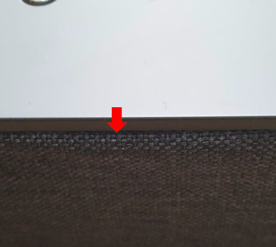
5. Grill attachment NG
Issue Description | Root Cause | Actions | Owner | Due Date | Status
Symptom : Grill attachment NG Type : Major Defect Q’ty : 1/244pcs Defect rate : 0.4% SKBSN: 214965001202109002041 | Incoming material issue. Vendor: INKEL 1. Visual inspection criteria did not define step standard of grill fabric adhesive. 2. At VI station, Op did not find the grill attachment NG. 3. IQC didn’t find the grill attachment NG issue based on the sampling plan C=0, AQL=0.4. 4. OBA didn’t find the grill attachment NG issue. | 1. Request RD provide inspection criteria Step for grill attachment. 2. Update NG picture to SOP for reminding OP at VI station to inspect grill fabric adhesive before put product into box. 3. Update the NG picture into IQC SIP. 4. Update the NG picture into the OBA SIP. 5. FXN SQE informs with vendor to improve this issue and give 8D report. | RD: Jim IE: Linh SQE: Tuan PQE: Robert SQE: Tuan | 11/30 Done Done Done 11/30

Slide 8
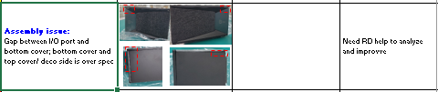
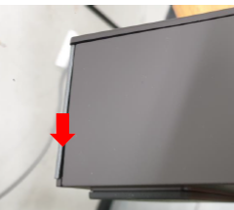
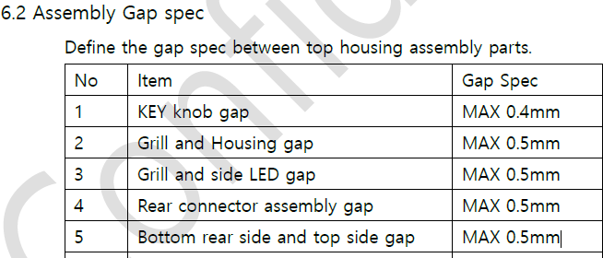
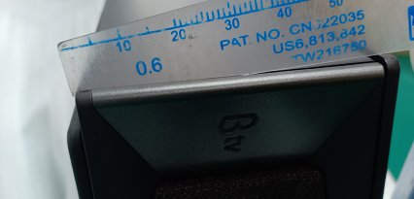
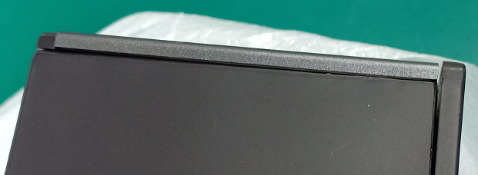
6. Side deco plate poor attachment
Issue Description | Root Cause | Actions | Owner | Due Date | Status
Symptom: Side deco plate poor attachment Type: Minor Defect Q’ty: Not counted Defect rate: about 10% | Design issue. This design issue had inform to ALT customer from NPI 07-Oct-2021. The gap between I/O port and bottom cover; bottom cover and top cover/ deco side is over spec. Gap spec. is 0.5mm. Actually gap between 0.6mm to 0.9mm. | 1. On 07-Oct-2021, FXN had highlighted this gap issue to ALT, and waiting ALT feedback. 2. Co-work with RD for update new visual inspection criteria for the GAP & STEP. | RD: Jim RD: Jim | TBD 11/30
GAP: over 0.6mm
After Assy, 100% GAP over spec

